Slide 1
Debugging Memory
Linux Kernel Memory Team

Slide 2
The foremost part of understanding Memory issues is to answer this question:
What consumes memory ?
In the beginning we have total RAM – let’s say 4GB
Certain parts of memory are reserved for non-HLOS functions – modem, TZ etc.
These reservations are documented for every target in ipcat – The start and end addresses of each reserved region. for e.g. http://ipcatalog.qualcomm.com/memmap/chip/53/map/345#block=1281177
Based on above documentation memory team carves out the non-HLOS regions in the device tree - http://qwiki.qualcomm.com/quic/Kernel/MemoryFAQ#How_to_change_memory_map
When Linux kernel boots, it reads the device tree and carves out the memory
What is left after this carveout is the so called HLOS memory.

Slide 3
How to verify these carveouts – from dmesg?
Open the dtsi file and go to reserved-memory section and look for nodes marked as “no-map”– These are the carveouts.
Get the dmesg from boot and look for “Removed memory” messages like this.
[ 0.000000] OF: reserved mem: initialized node camera_region@8ab00000, compatible id removed-dma-pool
[ 0.000000] Removed memory: created DMA memory pool at 0x000000008b000000, size 115 MiB
For each carveout node (no-map) in dtsi, you will find a corresponding dmesg message like above.
If you see more number of dmesg entries than in dtsi, its an indication of unwarranted carveouts.
Note that messages are printed only when in dtsi “compatible = "removed-dma-pool" is also set. When only no-map is used to carve out, we will have to go for memblock region interface (next slide)

Slide 4
How to verify these carveouts – from live target - memblock ?
Open the dtsi file and go to reserved-memory section and look for nodes marked as no-map – These are the carveouts.
Get the output of “cat /sys/kernel/debug/memblock/memory” – Each entry indicates base and end of region AVAILABLE to kernel
sdm845:/ # cat /sys/kernel/debug/memblock/memory
0: 0x0000000080000000..0x00000000856fffff
1: 0x0000000085f00000..0x0000000085fbffff
2: 0x0000000088f00000..0x000000008aafffff
3: 0x0000000096016000..0x00000000960fffff
4: 0x0000000096200000..0x000000017e3bffff
Thus the gaps indicate the carveouts.
Unwarranted carveouts are indicated by gaps not matching with the no-map entries of dtsi.

Slide 5
How to verify these carveouts – from live target - iomem ?
Open the dtsi file and go to reserved-memory section and look for nodes marked as no-map – These are the carveouts.
Get the output of “cat /proc/iomem | grep “System RAM”” – Each entry indicates base and end of region AVAILABLE to kernel
sdm845:/ # cat /proc/iomem | grep "System RAM"
80000000-856fffff : System RAM
85f00000-85fbffff : System RAM
88f00000-8aafffff : System RAM
96016000-960fffff : System RAM
96200000-17e3bffff : System RAM
Thus the gaps indicate the carveouts.
Unwarranted carveouts are indicated by gaps not matching with the no-map entries of dtsi.

Slide 6
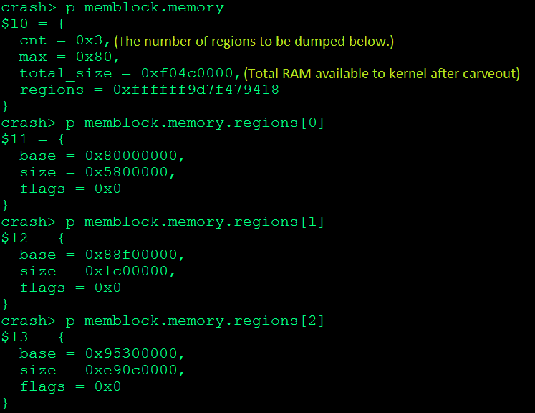
How to verify these carveouts – from ramdump ?

Slide 7
What is the memory available to kernel ?
Available kernel memory = Total RAM – Total size of carveouts, indicated by this dmesg entry
[ 0.000000] Built 1 zonelists in Zone order, mobility grouping on. Total pages: 965264

Slide 8
What kernel does with the available memory ?
From this available memory kernel does some reservations early at boot. Some of these include
Kernel code and data
Device tree
Per cpu areas
Kernel command line
Hash tables
memap – struct pages
Reserved memory can be seen by (Note that CMA pools are also shown here)
sdm845:/ # cat /sys/kernel/debug/memblock/reserved
0: 0x0000000080080000..0x0000000082c1bfff
1: 0x0000000083200000..0x000000008325858d
2: 0x0000000083400000..0x00000000835f3fff
3: 0x00000000f1800000..0x00000000ffbfffff

Slide 9
But who reserved these memory ?
/sys/kernel/debug/memblock/reserved does not show the owner.
But from a routine debugging perspective we don’t usually need to know the owner.
Keep a note of total reserved for a target – to catch aberration
Required only for reserved memory optimizations.
In such cases call stacks are enabled and memblock debug is enabled via “memblock=debug” kernel param.
Some of the reserved areas are shown by dmesg and /proc/iomem
[ 0.000000] PID hash table entries: 4096 (order: 3, 32768 bytes)
[ 0.000000] Dentry cache hash table entries: 524288 (order: 10, 4194304 bytes)
[ 0.000000] Inode-cache hash table entries: 262144 (order: 9, 2097152 bytes)
sdm845:/ # cat /proc/iomem | grep Kernel
80080000-8177ffff : Kernel code
81ea0000-82c1cfff : Kernel data

Slide 10
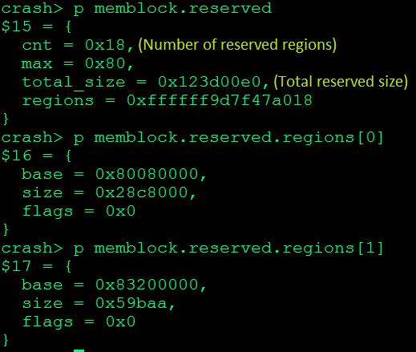
Reserved regions from ramdump

Slide 11
What is MemTotal of /proc/meminfo ?
MemTotal = Total RAM – carveouts – Reserved memory
This value is shown by “MemTotal” field of /proc/meminfo and “TOTAL MEM” field of crash command “kmem –i”
This data is shown by dmesg in the following manner
[ 0.000000] Memory: 3521288K/3922344K available (15740K kernel code, 2466K rwdata, 7748K rodata, 7296K init, 11324K bss, 196256K reserved, 204800K cma-reserved)
From the above message, 3521288K + 204800K cma_reserved + 7296K init becomes the MemTotal
MemTotal is the actual total memory available in the system once boot is completed.

Slide 12
What constitutes MemTotal ?
Answering this is fundamental to finding reasons for allocation failures, OOM and adj 0 task kills by lowmemorykiller.
MemTotal = MemFree + Buffers + Cached + zram_compressed + AnonPages + Slab + KernelStack + PageTables + Vmalloc + CMA contiguous allocations + ION + kgsl + Unaccounted memory

Slide 13
Finding values of memory components – live and ramdump

Slide 14
What is the memory consumed by user space ?

Slide 15
Some commonly used terms
Reclaim
The process of creating memory to serve allocation requests – by swapping, removing clean pages, writing back disk data to create clean pages, memory compaction to create higher order pages etc.
2 types – direct and kswapd
Kswapd is a kernel thread woken up from page allocation context when certain memory thresholds are breached. It runs asynchronously to generate memory.
Direct reclaim is the memory reclaim that is triggered from the context of memory allocation itself.
The memory threshold used by the reclaim code is called watermarks. Different levels of watermarks decide which kind of reclaim to be triggered.
Page order
Indicates the size of contiguous blocks in the buddy system
Order ‘n’ indicates a block of size PAGE_SIZE * (2^n). For e.g. with PAGE_SIZE 4K, and order 1 pages indicates a contiguous block of size 8K.
GFP MASK
A mask passed to page allocator indicating the kind of allocation and restrictions.

Slide 16
Some commonly used terms
GFP MASK
A mask passed to page allocator while allocating a page indicating the kind of allocation and restrictions.
__GFP_ATOMIC identifies callers that are truly atomic, cannot sleep and have no alternative. Means the allocator can’t do direct reclaim. In turn means, more likely to fail.
__GFP_DIRECT_RECLAIM identifies callers that can sleep and are willing to enter direct reclaim.
__GFP_KSWAPD_RECLAIM to identify callers that want to wake kswapd for background reclaim.
__GFP_HIGH identifies high priority callers.
Zones
Whole of memory is divided into multiple zones to simplify reclaim and also to let targeted allocations.
Memory allocations fall into 2 categories – Restricted to a zone and those which can fallback to another zone.
32 bit systems can contain “Normal” and “Highmem” zones. Certain allocations can come only from “Normal” zone. ___GFP_HIGHMEM must be set for an allocation to come from “Highmem” zone.
On 64 bit, there can be “DMA” and “Normal” zones.

Slide 17
Debugging allocation failure
Find the order and gfp_mask (mode below) from the failure message
326.050983: <6> mdev: page allocation failure: order:0, mode:0x2204000
Use ./scripts/gfp-translate in kernel folder to translate the mode to human readable form.
Figure out if reclaim is allowed or not by checking for the presence of __GFP_DIRECT_RECLAIM in mode. If not, this request can only get pages in the freelist and can’t do a memory reclaim to generate memory. Thus more likely to fail.
An order <=2 allocation with __GFP_DIRECT_RECLAIM set should not usually fail. Check for leaks.
>=3 allocations are considered costly and can fail depending on system fragmentation level. And its most likely to fail if __GFP_DIRECT_RECLAIM is not set. But always check for leaks.

Slide 18
Debugging allocation failure
Allocations can even have restrictions on which zone they can come from. So find these restrictions from the mode.
Note this sequence.
ZONE_DMA←ZONE_NORMAL←ZONE_HIGHMEM
Read this from right to left like this. An allocation targeted at:
ZONE_HIGHMEM can fallback to ZONE_NORMAL and then ZONE_DMA if it can’t find free page.
ZONE_NORMAL allocation can fallback to ZONE_DMA.
But a ZONE_DMA alloc can’t fallback anywhere.
Some of the zones can be absent depending on target.
The target zone can be derived from “mode”. __GFP_HIGHMEM will be set for ZONE_HIGHMEM and __GFP_DMA for ZONE_DMA. If neither is set and ZONE_NORMAL zone is present, alloc will target ZONE_NORMAL.

Slide 19
Debugging allocation failure
The available zones and their memory state is indicated by following messages printed on allocation failure.
Normal free: 3400kB min:2672kB low:4496kB high:5164kB active_anon:79180kB inactive_anon:79280kB active_file:58168kB
DMA free: 2200kB min:242kB low:232kB high:242kB active_anon:24566kB inactive_anon:323255kB active_file:2354kB
Thus from the targeted zone derived from “mode”, it is known which zone’s memory we have to account for to understand the failure.
Next, account memory so that a leak can be identified.

Slide 20
Accounting memory from allocation failure messages
An allocation failure does not cause a panic, so no ramdump.
Its hard to find certain leaks from failure messages alone because memory details of ION, kgsl, zram etc. are not printed. We plan to fix this on 4.9 by printing these details too.
Memory accounting can be done from the following set of messages
06-19 06:56:41.678 0 0 I Mem-info:
06-19 06:56:41.678 0 0 I Normal per-cpu:
06-19 06:56:41.678 0 0 I CPU 0: hi: 186, btch: 31 usd: 17
06-19 06:56:41.678 0 0 I CPU 2: hi: 186, btch: 31 usd: 87
06-19 06:56:41.678 0 0 I active_anon: 19795 inactive_anon:19820 isolated_anon:64
06-19 06:56:41.678 0 0 I active_file: 14542 inactive_file:13346 isolated_file:7
06-19 06:56:41.678 0 0 I unevictable: 64 dirty:0 writeback:269 unstable:0
06-19 06:56:41.678 0 0 I free : 850 slab_reclaimable:2635 slab_unreclaimable:6839
06-19 06:56:41.678 0 0 I mapped : 16063 shmem:195 pagetables:3723 bounce:0
06-19 06:56:41.678 0 0 I free_cma: 850
06-19 06:56:41.678 0 0 I Normal free: 3400kB min:2672kB low:4496kB high:5164kB active_anon:79180kB inactive_anon:79280kB active_file:58168kB inactive_file:53384kB unevictable:256kB isolated(anon):256kB isolated(file):28kB present:480256kB managed:459300kB mlocked:256kB dirty:0kB writeback:1076kB mapped:64252kB shmem:780kB slab_reclaimable:10540kB slab_unreclaimable:27356kB kernel_stack:8456kB pagetables:14892kB unstable:0kB bounce:0kB free_cma:3400kB writeback_tmp:0kB pages_scanned:680 all_unreclaimable? No
06-19 06:56:41.678 0 0 I lowmem_reserve[]: 0 0
06-19 06:56:41.678 0 0 I Normal : 336*4kB (C) 243*8kB (C) 7*16kB (C) 0*32kB 0*64kB 0*128kB 0*256kB 0*512kB 0*1024kB 0*2048kB 0*4096kB = 3400kB
06-19 06:56:41.678 0 0 I : 31188 total pagecache pages
06-19 06:56:41.678 0 0 I : 3103 pages in swap cache
06-19 06:56:41.678 0 0 I : Swap cache stats: add 193813, delete 190710, find 160099/221354
06-19 06:56:41.678 0 0 I : Free swap = 171308kB
06-19 06:56:41.678 0 0 I : Total swap = 338936kB
06-19 06:56:41.687 0 0 I : 120064 pages of RAM

Slide 21
Accounting memory from allocation failure messages

Slide 22
Why my allocation fails when there are free pages ?
It is not enough to have free pages of failed order for an allocation to succeed !
The following message may say that there are free pages of asked order
Normal : 336*4kB (C) 243*8kB (C) 7*16kB (C) 0*32kB 0*64kB 0*128kB 0*256kB 0*512kB 0*1024kB 0*2048kB 0*4096kB = 3400kB
For an allocation to succeed the watermarks must be satisfied.

Slide 23
Finding if the watermark is okay

Slide 24
Debugging OOM
Exactly similar to debugging allocation failure.
Failure messages are also similar, with OOM having extra information of all tasks, their adj values, RSS and swap
Note that in an oom message, “rss” = anon + file_mapped, and “swapents” = swap. So find the leaking task by searching for one with max value of “rss” + “swapents”.
OOM is a bug on our systems. Unlike allocation failures that are inevitable, OOM must be debugged and fixed.

Slide 25
Does LMK kill messages indicate anything bad ?
Not always.
Android keeps accumulating all the tasks opened by user and depending on certain memory thresholds, kills them one-by-one depending on certain priority.
Thus lowmemorykiller kills are usual, except when a oom_score_adj=0 task is killed. oom_score_adj 0 represents the foreground task and killing that is bad.
lowmemorykiller: Killing ‘Game-X’ (110), adj 0
When lowmem_debug_level is set to >=2 via /sys/modules/lowmemorykiller/paameters/debug_level, it prints message similar to allocation failure or OOM, when an adj 0 task is killed.
Thus debugging an LMK kill is similar to allocation failure or OOM debugging.

Slide 26
Why LMK is not killing tasks ?
Lowmemorykiller works on 2 thresholds.
These thresholds are defined as 2 arrays that can be accessed like below from ramdumps.
crash> lowmem_minfree
lowmem_minfree = $4 =
{15360, 19200, 23040, 26880, 34415, 43737}
crash> lowmem_adj
lowmem_adj = $5 =
{0, 100, 200, 300, 900, 906} ← Note that LMK never kills –ve oom_score_adj tasks.
lowmem_minfree is an array of pages, and lowmem_adj is an array of oom_score_adj.
The arrays are to be read like this, taking the last 2 elements as an e.g.: When both free memory and Cached of the system (not sum of them) goes below 43737 pages, lowmemorykiller can kill tasks with oom_score_adj >= 906.
Thus if LMK doesn’t kill, it means either the free or cached is higher than thresholds or there are no tasks with oom_score in that range.

Slide 27
Some hints
When swap is full (SwapUsed == SwapTotal), look for user space leaks. Remember task_size = anon + file_mapped + swap
If swap is full and no obvious leaks, find the memory consumed by lower adj tasks. LMK kills based on thresholds. If most of the memory is occupied by –ve or low oom_score_adj tasks, LMK wont kill them, thus creating freezes or alloc failures. Use “memutils –s” for this.
Look for the last execution time of “kswapd”. If kswapd is blocked, memory reclaim is stalled and can cause allocation failures.
In crash, “foreach bt” and grep for kswapd – get the stack
ps –l | grep kswapd to know the last execution time
See if any tasks are blocked in the memory reclaim path or IO. They may holding locks that’s not allowing kswapd to proceed.
When debugging customer issues, compare lowmem thresholds with values recommended by perf team.

Slide 28
Some hints
Unmovable allocation failures and lot of free memory– See if most of the free memory is free_cma. Unmovable allocations can’t be served from CMA.
Especially in customer dumps, if anon space is high and there is free swap look for NR_MLOCK in kmem –V, or nr_mlock in the allocation failure messages. Mlocked pages can’t be swapped. There can be buggy user space code that mlocks huge number of pages.

Slide 29
Use for Qualcomm Technologies, Inc.

